Slide 1


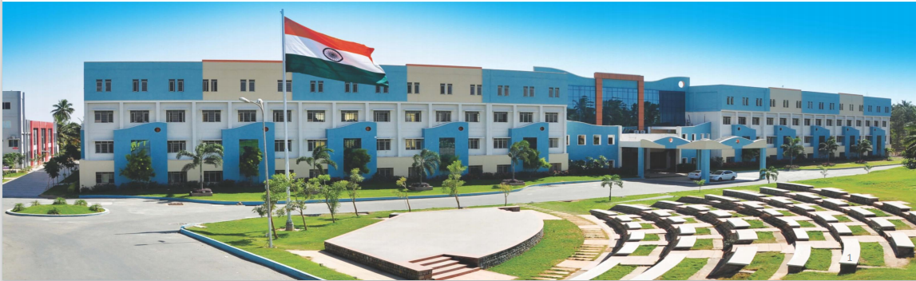
TECHFUSION ’24 HACKATHON

Slide 2
Project Title: EYE LINK
Team Name: Pixel Pioneers
Theme: Smart Knowledge
S.No | Name | Department | Year & Section | Mobile Number | Email Id
1. | TARUN J | AI-DS | I - C | 9677752642 | tarun.j2023ai-ds@sece.ac.in
2 | SUTHISH BALAJI R | AI-DS | I - C | 8122782482 | suthishbalaji.r2023ai-ds@sece.ac.in
3 | MONISH T | MECH | I | 8610083896 | monish.t2023mech@sece.ac.in
4 | SAMRAT C | MECH | I | 8248492258 | samrat.c2023mech@sece.ac.in

Slide 3

Problem Statement/Description
Many differently abled individuals still face substantial barriers in their daily lives due to a lack of effective assistive technologies. This gap limits their ability to participate fully in educational, professional, and social environments, impacting their independence and quality of life.

Slide 4
Problem Statement/Description
Current assistive technologies often do not fully address the diversity of disabilities, and many are prohibitively expensive, not user-friendly, or inadequately integrated with other technology platforms. Additionally, rapid technological changes can render assistive devices obsolete quickly, thereby straining the financial resources of those who depend on them the most

Slide 5

Proposed Solution/Methodology
Differently abled individuals often face significant challenges in interacting with digital technology, particularly those with motor impairments that limit the use of conventional input devices like keyboards and mouse. Eye trackers offer a groundbreaking solution by enabling these individuals to control computers and other devices using just their eye movements, thereby overcoming several key difficulties

Slide 6
Market Size and Statistics
Global Reach: The global eye tracking market has been expanding steadily. Reports from around 2020 estimated the market size to be around $300 million to $400 million. Projections from then anticipated a robust growth, with expectations to reach between $1 billion and $1.8 billion by the mid-2020s.
Compound Annual Growth Rate (CAGR): The eye tracking market has been projected to grow at a CAGR of approximately 24% to 27% during the period from 2020 to 2025. This growth rate reflects both technological advancements and expanding application areas.

Slide 7
Gap Analyzed with existing solutions
Cost Accessibility:
Existing Gap: Many high-quality eye trackers, especially those used in research and assistive technology, are priced beyond the reach of individuals, small businesses, or educational institutions with limited budgets.
Opportunity: Introducing a low-cost eye tracker could democratize access to this technology, making it available for users who need basic eye tracking capabilities for education, light research, or personal use without requiring large investments.
2. Geographical Availability:
Existing Gap: Distribution and support for high-end eye trackers are often limited to developed countries or specific regions, leaving potential users in emerging markets underserved.
Opportunity: Offering a low-budget eye tracker with wide availability and support in multiple languages

Slide 8
Gap Analyzed with existing solutions
3. Feature Customization:
Existing Gap: Many eye trackers come with a wide range of features that may not be necessary for all users, contributing to higher costs.
Opportunity: Providing a customizable eye tracker where users can choose only the features they need or pay for software upgrades could make the base product more affordable and flexible.
2. Ease of Integration and Use:
Existing Gap: Research-grade and industrial eye trackers often involve complex setup procedures and require technical expertise to operate and interpret the data.
Opportunity: A simplified, plug-and-play eye tracker with an intuitive user interface and basic software could attract users who are less technically savvy

Slide 9
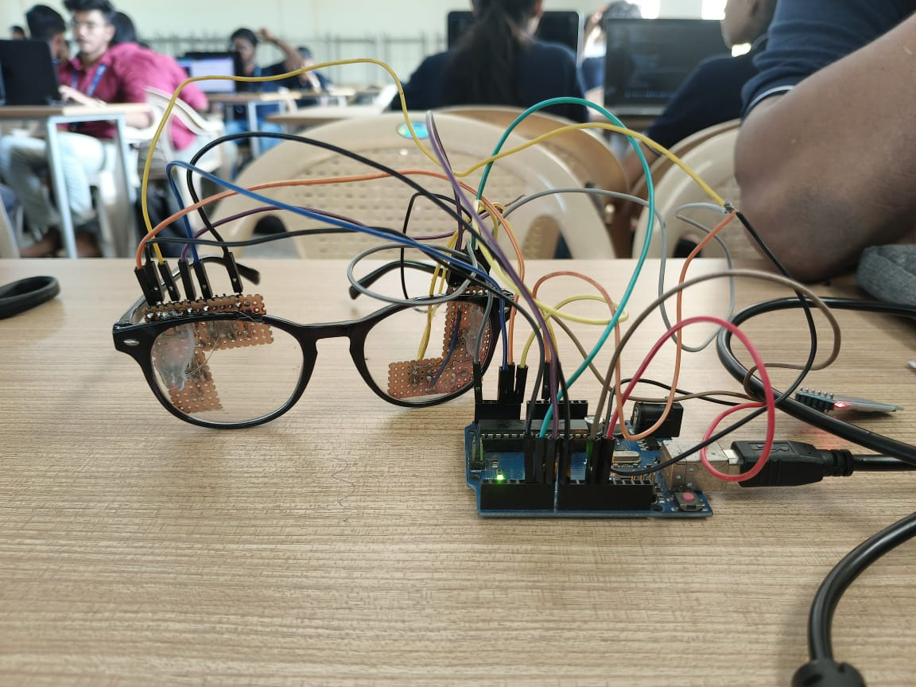
Prototype & Its current level
Our eye tracker is currently 90% complete, and we are excited about the future possibilities; we plan to implement many innovative ideas to enhance its functionality, improve user accessibility, and expand its applications across various fields

Slide 10
Social Impact
1.Enhancing Accessibility for Individuals with Disabilities
2.Advancing Educational Opportunities
3.Improving Healthcare Outcomes
4.Facilitating Medical Diagnoses and Research

Slide 11
Technology suppliers (sensors)
Software development firms
Healthcare organizations and clinics
Disability advocacy groups
Consumer electronics manufacturers
Automotive companies
Research and development
Software programming and algorithm optimization
Product design and manufacturing
Quality assurance and testing
Marketing and distribution
Customer support
Compliance with regulations
Enhanced accessibility for disabled individuals
Improved safety features in automotive through driver monitoring
Innovative user interface options for consumer electronics
Customizable and scalable solutions for various markets
Direct support and training for institutional clients (e.g., hospitals, schools)
Online support and community engagement for end-users
Long-term partnerships with business clients
Feedback mechanisms to improve product features
Individuals with disabilities
Healthcare providers and rehabilitation centers
Academic researchers and educational institutions
Automotive manufacturers
Gamers and general consumers in the tech-savvy market
Engineering team (hardware/software)
Sales and marketing team
Customer service staff
Intellectual property (patents, trademarks)
Manufacturing facilities or partners
Funding and investment
Direct sales through the company website
Distribution through medical device suppliers
Partnerships with consumer electronics retailers
Online platforms and social media for marketing and engagement
Research and development costs | Manufacturing and production costs
Marketing and sales expenses | Licensing fees | Partnership
Sales of eye tracking devices
Licensing software and technology to other companies
Contract research and development services
Diffrently Abled
Pixel Pioneers
1.0

